Slide 1

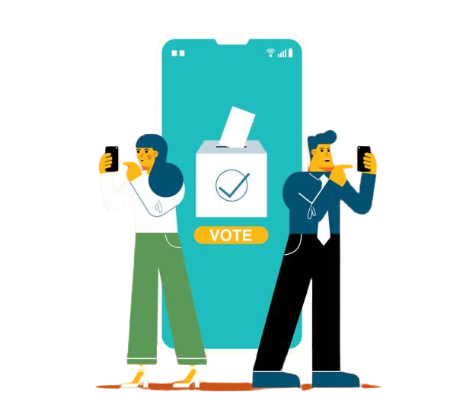

Votezy
A Spring Boot-Based
Online Voting Application

Slide 2



Introduction
Votezy is a Spring Boot-based web application designed to enable efficient and transparent voting.
This system allows candidates and voters to register, allows voters to cast their votes, and finally view the election results.

Slide 3
System Architecture
The system follows a three-tier architecture:
01
03
02
Presentation Layer:
Data Layer:
Business Layer:
REST API endpoints exposed through Spring Boot controllers.
Spring Data JPA for database interactions with MySQL.
Business logic for voting, election results, and validation.

Slide 4

Application Work Flow
1️⃣ Voter & Candidate Registration
Voters register with their name and email.
Candidates register with their name and party.
ID allotment will be automatic.

Slide 5
Application Work Flow
2️⃣ Casting a Vote
A registered voter selects a candidate and submits his/her vote

Slide 6
Application Work Flow
3️⃣ Viewing Election Results
On just a button click the system calculates votes and displays the election results.

Slide 7

Special Cases Handled
✅ A voter cannot vote twice in the same election.
✅ A voter cannot vote for a non-existing candidate.
✅ A non-registered voter is not allowed to cast vote.

Slide 8

Modules
01
Voter Module:
- Register Voter
- View Voter Details
02
Candidate Module
Register Candidate
View Candidate Details

Slide 9
Modules
03
Voting Module:
- Cast votes
- Track voter participation
04
Election Result Module:
- Calculate and display election results

Slide 10

Database Design
Tables:
📌 Voter: Stores voter details (ID, Name, Email, hasVoted)
📌 Candidate: Stores candidate details (ID, Name, Party, Vote Count)
📌 Vote: Tracks votes (ID, Voter ID, Candidate ID)
📌 ElectionResult: Stores election results (ID, Winner ID, Total Votes)

Slide 11

Technologies/Topics Used
01
Spring Core
02
Spring Boot
03
Spring Data JPA
04
RESTful API
05
MySQL
06
Relationships
07
Lombok
08
Exception Handling

Slide 12
Extra Features That Can Be Added
Authentication
&
Authorization
Live Voting Progress With Vote Scheduling
AI- Based Fraud Detection
Multi-Tenant Election Management

Slide 13



Conclusion
Votezy provides:
Hassle free voting
Transparent election results
Easy voter and candidate management

Slide 14




Contact Us
Email Address
info@scalive.in
Phone Number
+91 7314853128, +91 9826686245
Website
www.scalive.in

